Slide 1

Global growth development indicators analysis-CLUSTERING
Group 5

Slide 2
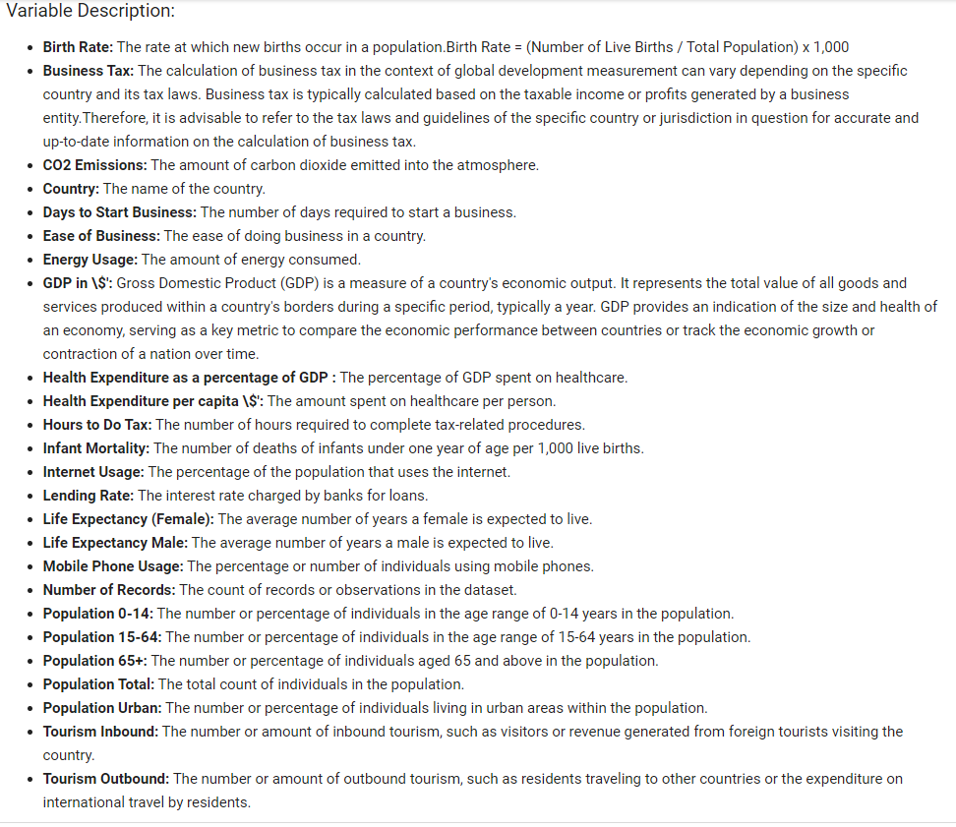
Domain Research Content

Slide 3
Business understanding about project
Based on the given data here are a few potential segmentation approaches that we may considered for our clustering project:
Economic Segmentation :Economic variables like "GDP," "CO2 Emissions," "Tourism Inbound," "Tourism Outbound," "Lending Interest," and "Business Tax Rate" can be used for economic segmentation. This approach can identify countries or regions with similar economic characteristics, such as GDP levels, tourism activities, or business regulations.
Demographic Segmentation:using the provided population-related variables, we can expect the final classification to group countries or regions based on their population size, age distribution, and urbanization levels.
Technological Segmentation : Variables such as "Mobile Phone Usage," "Internet Usage," and "Energy Usage" can be used for technological segmentation. This approach can help identify countries or regions with similar levels of technology adoption or energy consumption patterns.
Health and Social Segmentation : Variables like "Birth Rate," "Life Expectancy Male," "Life Expectancy Female," "Infant Mortality Rate," "Health Exp/Capita," and "Health Exp % GDP" can be used for segmentation related to health and social indicators. This segmentation can help identify groups of countries with similar health outcomes, healthcare spending, or life expectancy.

Slide 4
To define our clustering project goal based on the columns provided,
we need to analyze the data and identify patterns or relationships among the variables.
Here are some possible goals we could consider with the given data:
Analysing countries based on their economic indicators:
GDP
Business tax rate
Lending interest
Energy usage
CO2_Emissions
Analysing countries based on their social/health indicators:
Birth rate
Infant mortality rate
Life expectancy (female and male)
Population demographics (0-14, 15-64, 65+)
Health expenditure (GDP and per capita)
Analysing countries based on their environmental indicators:
CO2 emissions
Energy usage
Project GOAL : Cluster countries based on a combination of economic, social, and environmental indicators to identify overall development levels.
Tourism Inbound
Tourism Outbound

Slide 5
Economic Segmentation : Economic variables like "GDP," "CO2 Emissions,"
"Tourism Inbound," "Tourism Outbound," "Lending Interest," and "Business Tax Rate"
can be used for economic segmentation. This approach can identify countries or regions with similar economic characteristics, such as GDP levels, tourism activities, or business regulations.
Cluster 1: High GDP, significant tourism activities, low CO2 emissions, low lending interest rates, and favorable business tax rates.
This cluster may represent economically prosperous countries or regions with a strong tourism industry, low environmental impact, attractive business conditions, and relatively low borrowing costs.
Cluster 2: Moderate GDP, moderate tourism activities, moderate CO2 emissions, moderate lending interest rates, and moderate business tax rates.
This cluster may represent countries or regions with a moderate level of economic development and a balanced approach to tourism, environmental impact, financial policies, and business regulations.
Cluster 3: Low GDP, limited tourism activities, high CO2 emissions, high lending interest rates, and high business tax rates.
This cluster may represent economically less developed countries or regions with limited tourism activities, higher environmental impact, relatively higher borrowing costs, and less favorable business tax rates.
Cluster 1: "Prosperous" / ‘developed’ Cluster 2: "Moderate" OR ,’developing’ Cluster 3: "Underdeveloped" or "Challenged"
Cluster 1: High GDP, significant tourism activities, low CO2 emissions, low lending interest rates, and favorable business tax rates.
This cluster may represent economically prosperous countries or regions with a strong tourism industry, low environmental impact, attractive business conditions, and relatively low borrowing costs.
Cluster 2: Moderate –high GDP, moderate tourism activities, moderate CO2 emissions, moderate lending interest rates, and moderate business tax rates.
This cluster may represent countries or regions with a moderate level of economic development and a balanced approach to tourism, environmental impact, financial policies, and business regulations.
Cluster 3: Low –medium GDP, limited tourism activities, high CO2 emissions, high lending interest rates, and high business tax rates.
This cluster may represent economically less developed countries or regions with limited tourism activities, higher environmental impact, relatively higher borrowing costs, and less favorable business tax rates.
Cluster 4: Low GDP, limited tourism activities, high CO2 emissions, high lending interest rates, and high business tax rates.
This cluster may represent economically less developed countries or regions with limited tourism activities, higher environmental impact, relatively higher borrowing costs, and less favorable business tax rates.
CLUSTER 1: HIGH CLUSTER 2: “HIGH TO MEDIUM " CLUSTER 3: “MEDIUM TO LOW
CLUSTER 4 :LOW

Slide 6
Data Cleaning:
EDA
Handling Missing Values:
Identify missing values.
Assess the impact of missing values.
Decide on handling strategies.
Implement chosen strategy.
Handling Inconsistent Data:
Identify inconsistencies.
Identify and eliminating duplicate
Validate data against business rules.
Eliminating Redundant Features:
Exclude Columns that have Redundant Information
Outlier Detection and Treatment:
Identify outliers using boxplots.
Assess impact and decide treatment.
Implement chosen treatment.
Data Transformation:
Normalize and standardize data.
Handle skewness.
Percentage to values
Data Reduction:
understanding Feature Importance
Data Exploration:
Statistical summaries and descriptive statistics.
Univariate Analysis : Analyze each variable individually to understand its distribution.
Data visualization.
Variable Identification:
Determine the role of each variable grouping variable, and understand their significance in the analysis.

Slide 7
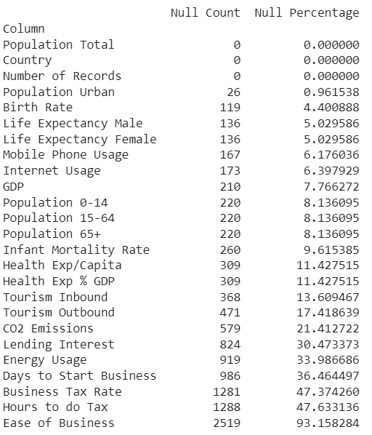
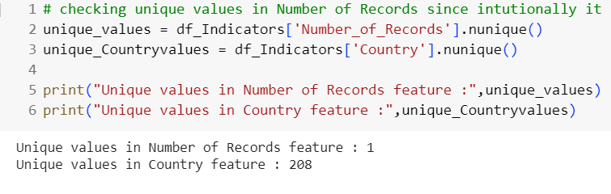
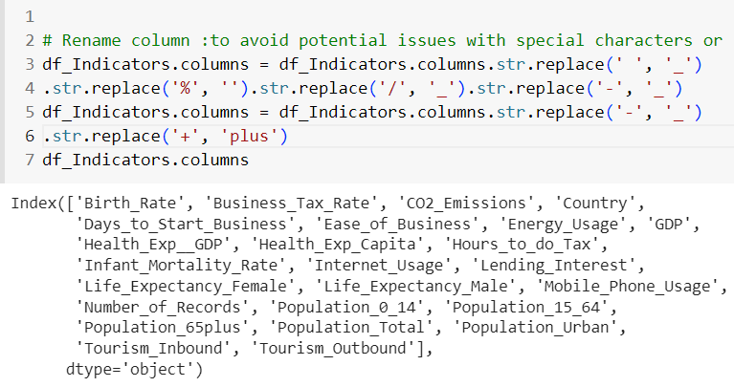
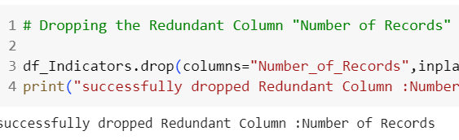
MISSING Values (Null):
Except for Country, Number of Records, and Population Total, all the other columns had null values.
‘Ease of Business ‘ has 93% missing values thus retaining it may include bias .
Redundant Column:
"Number of Records“ has a single unique value ‘1’ implies that the feature lacks variability and does not exhibit any distinguishable patterns within the dataset. Thus this column is dropped.
Column Names:
changed the column names to avoid potential issues with special characters or spaces.

Slide 8
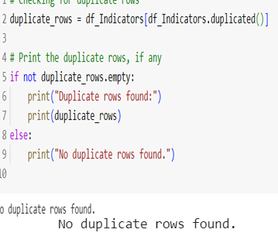
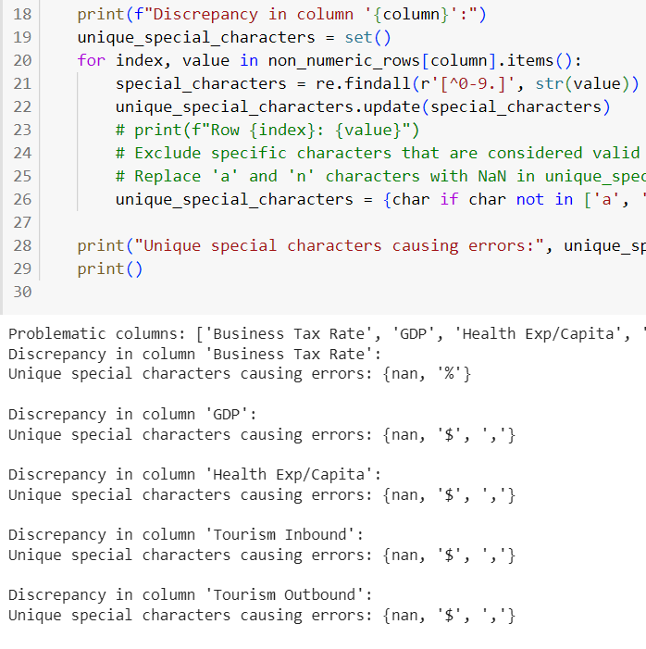
Inconsistent Data:
Identify and eliminating duplicate values
Identify inconsistencies;
Identified and eliminated the special characters present in the data
Column Names:
There are total 208 unique countries and each country has 13 records ,hence we can assume the data is periodic.

Slide 9
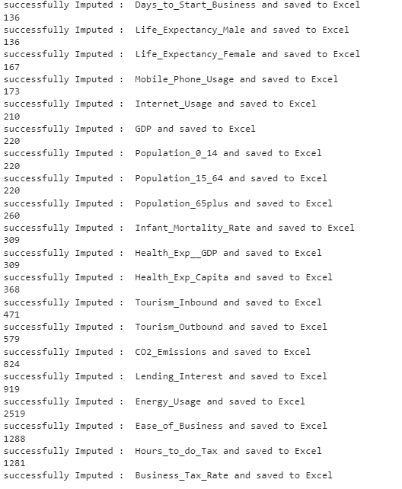
Handling Missing Values:
KNN Imputer, Regression imputer
Implement chosen strategy : KNN Imputer
We first used the relationship between the population columns
Converted the Population 0-14, Population 15-64 ,Population 65 percetage to values and checked for imputed the missing values using the formula - sum(Population 0-14, Population 15-64 ,Population 65) = Population Total but the 20 rows with empty values had all the 3 columns missing.
Thus targeting the least missing values imputed iteratively for all the columns using KNN.

Slide 10
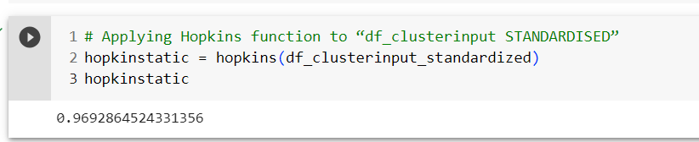
Assessing Clustering Tendency – statistical method
Statistic Hopkins test -The Hopkins statistic is a way of measuring the cluster tendency of a data set.
Since the Hopkins statistic (H) is close to 1, it indicates that the data points in the dataset
are not uniformly distributed and have a significant tendency to form clusters.
We conclude that the dataset is suitable for clustering.

Slide 11
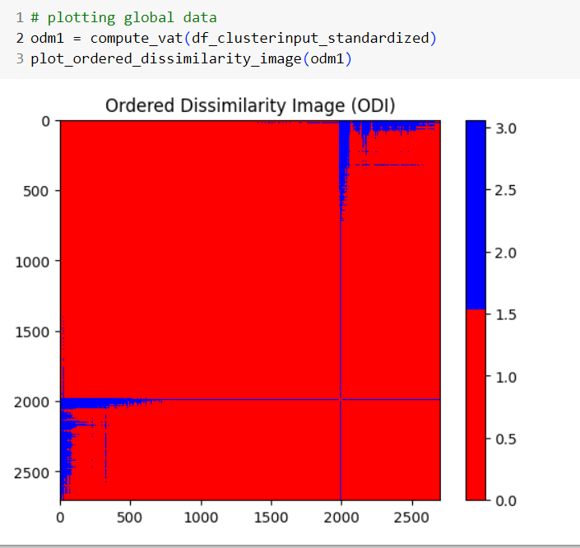
Assessing Clustering Tendency – visual method
Red: high similarity (ie: low dissimilarity) |
Blue: low similarity.
The dissimilarity matrix image confirms that there is a cluster structure in the given data set.
The color level is proportional to the value of the dissimilarity between observations: pure red if dist(xi,xj)=0
and pure blue if dist(xi,xj)=1
. Objects belonging to the same cluster are displayed in consecutive order.

Slide 12
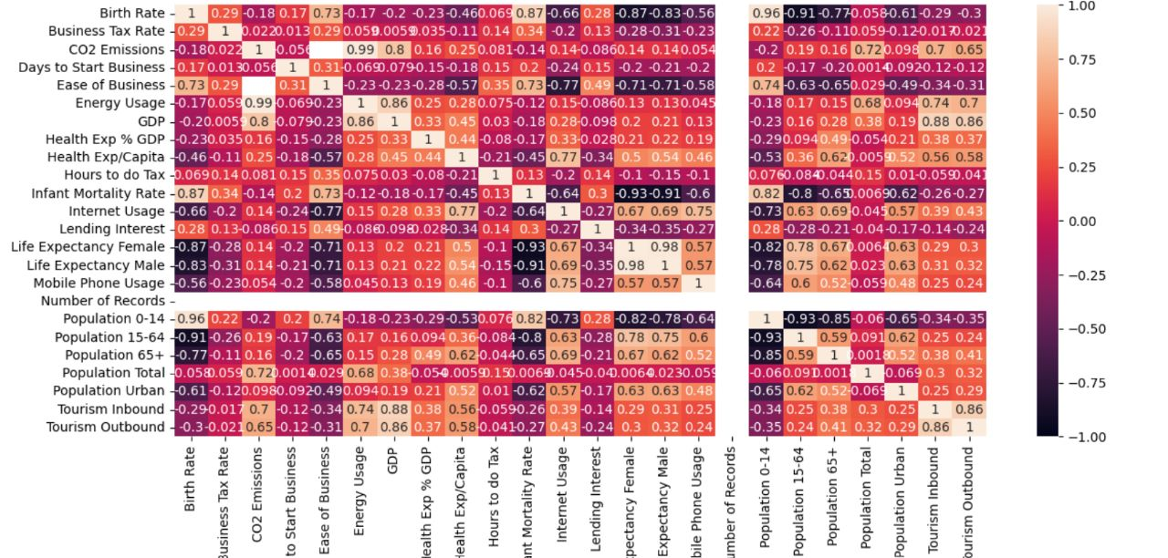
Story telling with Data:
Variable Identification: Determine the role of each variable grouping variable,
and understand their significance in the analysis.
Correlations matrix

Slide 13
Implications for Policy and Healthcare Interventions
Birth Rate and Infant Mortality Rate: The high positive correlation suggests that countries with higher birth rates tend to have higher infant mortality rates. This finding can guide policymakers like UNICEF and healthcare professionals in identifying regions/countries that require improved maternal and child healthcare services and targeted interventions to reduce infant mortality rates.

Slide 14
Strategies for Sustainable Energy Practices and Carbon Footprint Reduction
CO2 Emissions and Energy Usage: The strong positive correlation between CO2 emissions and energy usage indicates that countries with higher energy consumption tend to generate more carbon emissions. This information can be utilized to develop strategies for promoting energy-efficient practices, renewable energy adoption, and carbon footprint reduction initiatives.

Slide 15
Implications for Policy and Support for Aging Populations
Life Expectancy and Population Age Group 65+: The POSITIVE correlations between life expectancy and population age group (65+) indicate that countries with higher life expectancies tend to have higher proportions of youth and older populations. This knowledge can guide policymakers UNESCO and UNICEF in developing policies and programs that address the needs of aging populations, such as healthcare, social welfare, and pension systems.

Slide 16
Strategies for Enhancing Tourism Experiences and Economic Impact
Tourism Inbound and Tourism Outbound: The positive correlation between inbound and outbound tourism suggests that countries with higher tourist arrivals also tend to have higher outbound tourism from their own citizens. This insight can be leveraged by tourism authorities to develop comprehensive tourism strategies that cater to both international tourists and domestic travelers, enhancing the overall tourism experience and economic impact.

Slide 17
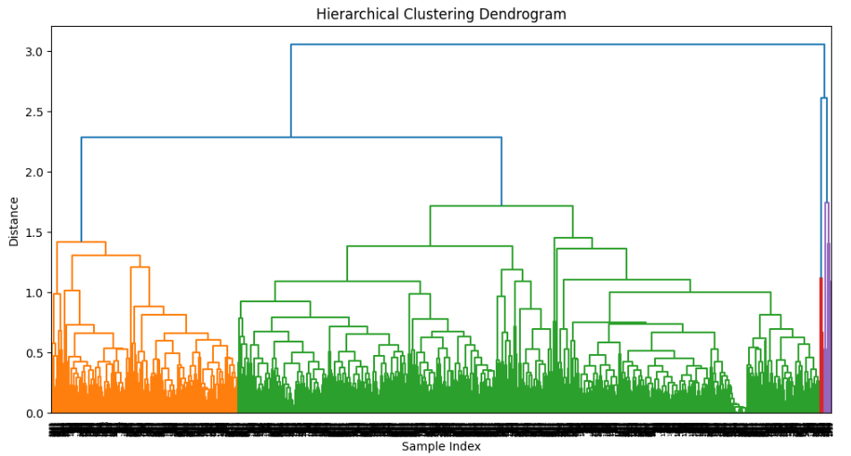
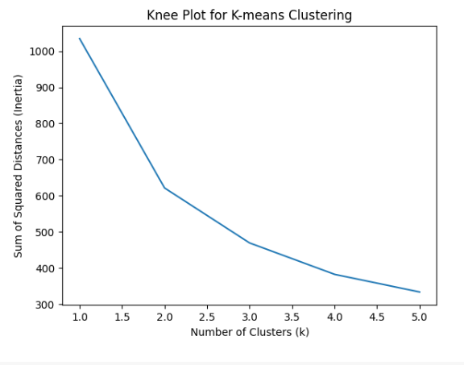
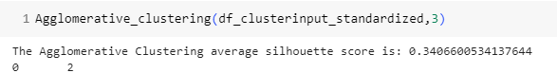
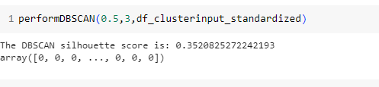
Model Building/ Cluster Validation: – With All the Features
After hyper parameter tuning :

Slide 18
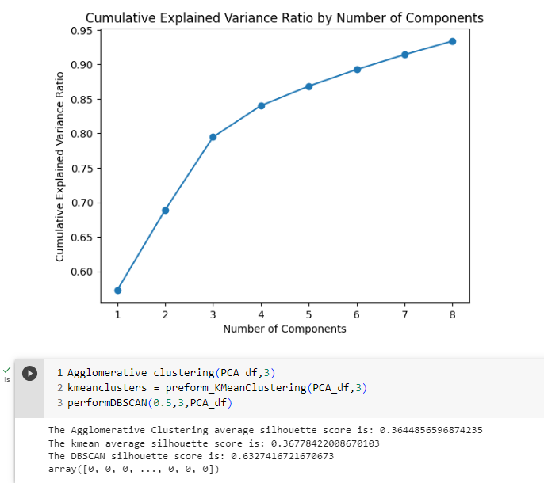
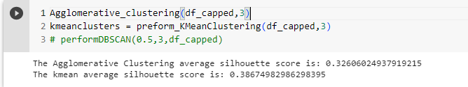
Implementing the model using PCA
And capping of outliers.

Slide 19
Model Building/ Cluster Validation: – With selective features

Slide 20
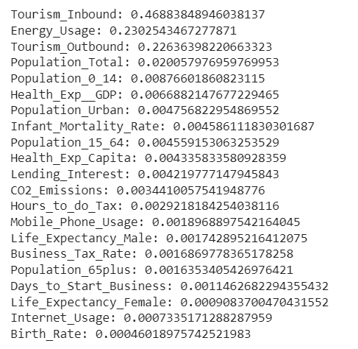
Feature Importance : Feature Importance using RandomForestRegressor Forward feature selection
Tourism_Inbound: 0.4189423953651524
Energy_Usage: 0.2642171909326924
Tourism_Outbound: 0.24370149647930692
Population_Total: 0.017634449824078205
Health_Exp__GDP: 0.007796635094896971
Population_0_14: 0.007121295418779614
Lending_Interest: 0.005618171639311713
Health_Exp_Capita: 0.004728521135729467
Hours_to_do_Tax: 0.004584134431992724
Population_Urban: 0.0031766600582651934

Slide 21
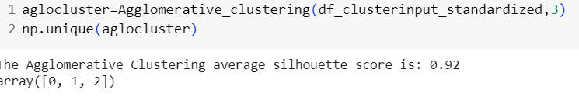
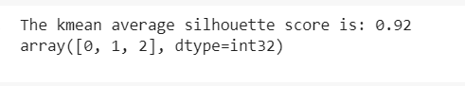
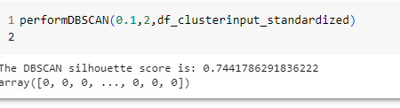
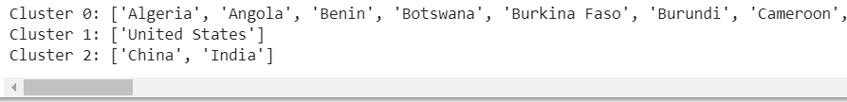
Feature selection based on Importance
'GDP','Tourism_Inbound','Energy_Usage',"Tourism_Outbound","Population_Total“
(3 clusters)
Cluster0 = underdeveloped , cluster1 developed ,cluster2 :developing

Slide 22
Profiling the clusters-Insights
Interpretation and Visualization:

Slide 23
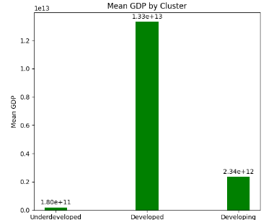
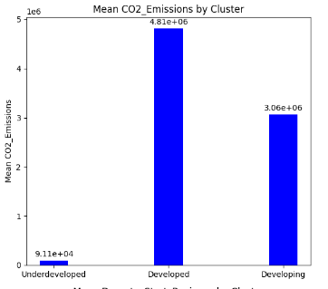
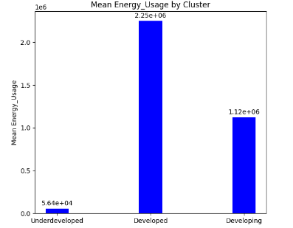
Profiling of Clusters
Transition to Renewable Energy: Encourage the adoption of renewable energy sources such as solar, wind, and geothermal power to reduce reliance on fossil fuels. Provide incentives and subsidies for renewable energy projects, invest in research and development, and facilitate the integration of renewable energy into the existing infrastructure.
Energy Efficiency Programs: Implement energy efficiency programs to promote the use of energy-efficient technologies and practices in industries, buildings, and transportation. This can include energy audits, tax incentives for energy-efficient upgrades, and stricter energy efficiency standards.
Carbon Pricing and Emissions Trading: Implement carbon pricing mechanisms such as carbon taxes or emissions trading systems to incentivize businesses to reduce their carbon emissions. This can create a market-driven approach to emissions reduction and encourage investment in clean technologies.
Sustainable Transportation: Encourage the adoption of electric vehicles (EVs) and invest in charging infrastructure. Develop public transportation systems and promote cycling and walking as alternative modes of transportation. Implement policies to reduce traffic congestion and encourage carpooling.
Green Building Initiatives: Implement green building standards and certifications to promote energy efficiency and sustainable practices in the construction sector. Provide incentives for the retrofitting of existing buildings to improve energy efficiency and reduce environmental impact.
Collaboration and International Cooperation: Foster collaboration among governments, businesses, and international organizations to share best practices, technology transfer, and financial resources. Engage in international climate agreements and initiatives to address global environmental challenges collectively.
Lesson for ALL

Slide 24
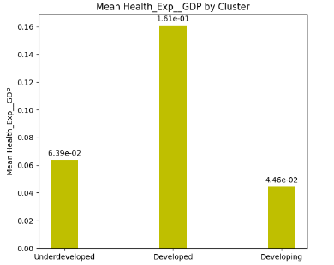
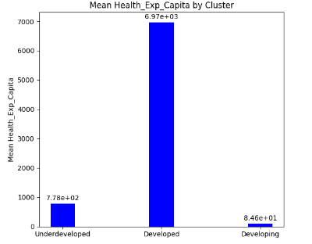
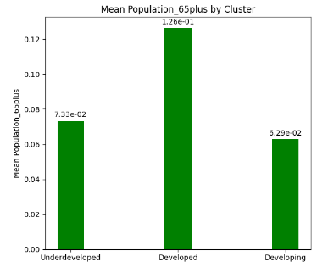
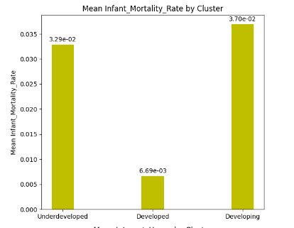
For underdeveloped/developing countries :Collaborate with International Partners: Seek partnerships and collaborations with
international organizations, NGOs, and donor agencies to access technical
expertise, financial resources, and knowledge sharing. Leverage international
support to strengthen healthcare systems, improve infrastructure, and implement
targeted health interventions.
Strengthen Health Governance and Policies: Improve health governance by
implementing transparent and accountable healthcare systems.
Develop and enforce policies that prioritize public health, healthcare quality,
and patient safety. Strengthen health information systems for data collection,
analysis, and evidence-based decision-making.
Empower Communities: Encourage community participation and engagement in health programs.
Involve local leaders, community health workers, and civil society organizations in the design,
implementation, and monitoring of health interventions. Promote community ownership and
empowerment to drive sustainable improvements in health outcomes.
.

Slide 25
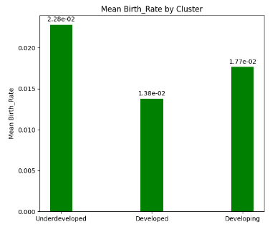
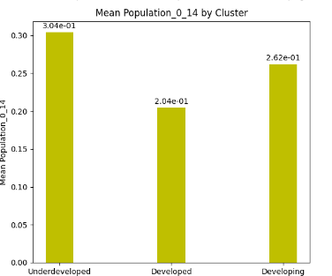
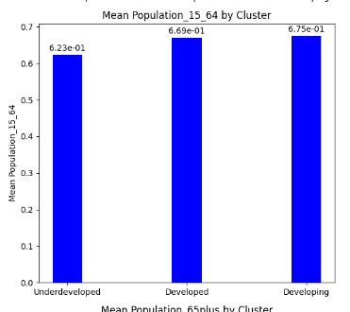
Developing and underdeveloped countries can Harnessing Demographic Dividend: Building a skilled workforce through education and vocational training programs can enable developing countries to capitalize on their working-age population, enhance productivity, and drive economic growth.

Slide 26
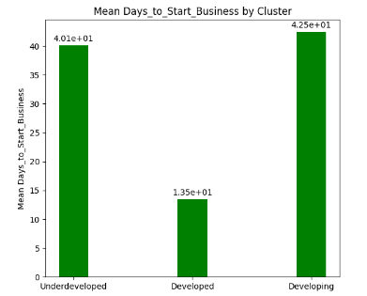
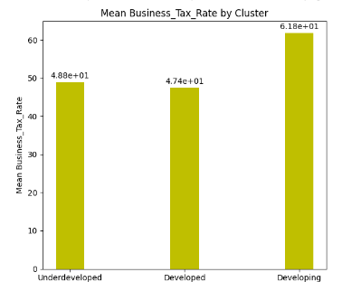
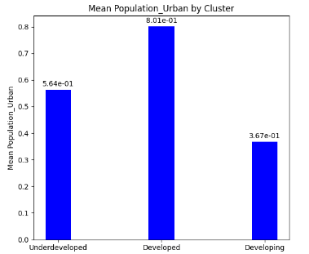
Streamlined Business Processes: Developing countries can learn from low days to
start a business in high GDP countries and work towards simplifying administrative
processes, reducing bureaucratic barriers, and implementing efficient business re
gistration systems.
b. Investment-Friendly Policies: Emulating countries with lower tax rates,
developing nations can introduce tax reforms and incentives to attract investment,
stimulate economic growth, and encourage entrepreneurship.
c. Urban Development and Infrastructure: Developing countries can focus on urban
planning, infrastructure development, and the provision of essential services in urban areas to attract businesses
, foster innovation, and create employment opportunities.

Slide 27
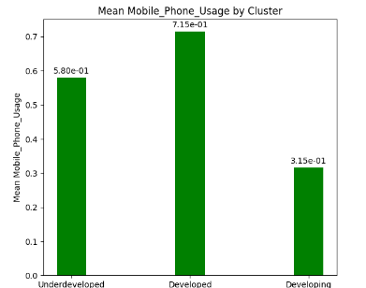
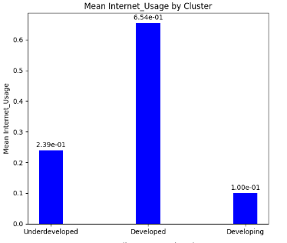
An increased usage of phones is a common trend observed across developed, underdeveloped, and developing countries. This trend reflects the global advancement and widespread adoption of technology, communication infrastructure, and digital connectivity.
When there is an increase in phone usage but less internet usage, it presents unique business scenarios that can be explored like : Voice-based Services, SMS-based Solutions, Offline Applications, Telephony-based Payment Systems, Phone-based Marketplaces.
These business opportunities aim to cater to the needs of people who primarily use phones for communication but have limited access to the internet. By adapting services to work through phone networks, businesses can reach and serve this audience effectively additionally exploring opportunities for connectivity market and business.

Slide 28
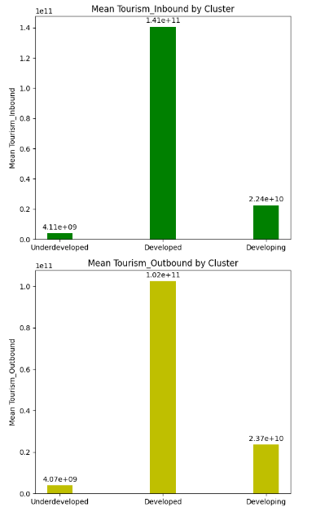
promote Domestic Tourism: Encourage residents to explore and appreciate their own country by promoting domestic tourism. Highlight unique local attractions, cultural heritage sites, natural landscapes, and diverse experiences through targeted marketing campaigns and incentives.
Develop Sustainable Tourism Infrastructure: Invest in developing sustainable tourism infrastructure and facilities within the country to attract both domestic and international tourists. Enhancing the quality and accessibility of tourism offerings can make the local tourism experience more appealing and competitive.
Support Local Tourism Businesses: Provide support and incentives to local tourism businesses, such as hotels, restaurants, tour operators, and transportation services. Encouraging their growth and ensuring their competitiveness can contribute to a vibrant domestic tourism industry and reduce the need for outbound travel.
Education and Awareness: Raise awareness about the economic, social, and environmental benefits of supporting local tourism. Educate residents about the significance of domestic tourism, its positive impact on local economies, and the preservation of cultural heritage and natural resources.
Community Engagement: Engage local communities in tourism development and decision-making processes. Involve residents in planning, promoting, and benefiting from local tourism initiatives, fostering a sense of ownership and pride in their own destinations.
Price Competitiveness: Ensure that domestic tourism offerings are competitively priced compared to outbound travel options. Explore partnerships with local businesses to offer special discounts, packages, or incentives to attract residents and make domestic tourism more affordable.
Diversify Tourism Products: Develop a diverse range of tourism products and experiences that cater to different interests and preferences of residents. This can include adventure tourism, ecotourism, cultural tourism, culinary tourism, and wellness tourism, among others.
Strengthen Tourism Marketing: Invest in effective domestic tourism marketing campaigns to create awareness, generate interest, and promote the unique attractions and experiences within the country. Utilize various channels such as digital marketing, social media, and traditional advertising to reach and engage potential domestic tourists.
Collaboration with Travel Industry: Collaborate with travel agencies, airlines, and other travel industry stakeholders to design attractive domestic travel packages and itineraries. Encourage travel agents to promote domestic destinations and experiences as alternatives to international travel.
Government Policies and Incentives: Implement policies and provide incentives that support the growth of domestic tourism. This can include tax incentives for tourism businesses, funding for infrastructure development, and regulations that promote sustainable tourism practices.

Slide 29
Insights and Decision Making: Business Solution based on the feature relationships that can be utilized in different domains powered with the identified clusters.
Healthcare Technology and Services: With the positive correlation between health expenditure as a percentage of GDP and life expectancy, there is an opportunity for businesses in the healthcare sector. Companies can develop innovative healthcare technologies, telemedicine platforms, and digital health solutions to improve accessibility and quality of healthcare services. Collaborating with governments and insurance providers can further expand the reach of these solutions.
E-commerce and Mobile Technology: Given the strong positive correlation between internet usage and mobile phone usage, businesses can leverage the growing digital landscape. E-commerce companies can invest in user-friendly mobile applications, optimize their websites for mobile browsing, and enhance the overall customer experience. Additionally, businesses can explore mobile advertising and digital marketing strategies to target the increasing mobile user base.

Slide 30
Child and Family-oriented Businesses: With the strong positive correlation between birth rate and the population of individuals aged 0-14, businesses can target the child and family market. This can include products and services related to childcare, education, entertainment, and family-oriented experiences. Companies can develop innovative toys, educational tools, family-friendly resorts, or organize family events and activities.
Tourism and Hospitality: Considering the positive correlations between tourism inbound and various factors such as GDP, internet usage, and population urbanization, businesses can explore opportunities in the tourism and hospitality sector. This can involve setting up hotels, resorts, and restaurants in popular tourist destinations, offering unique travel experiences, or providing transportation and travel-related services.

Slide 31
Exploring the clustering by different features and number of clusters.

Slide 32
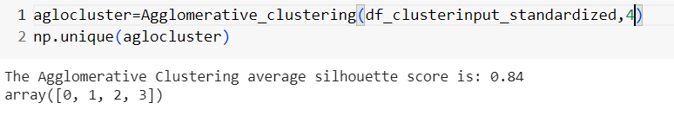
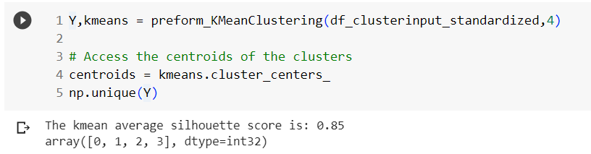
Feature selection
'GDP','Tourism_Inbound','Energy_Usage',"Tourism_Outbound","Population_Total“
(4 clusters)

Slide 33
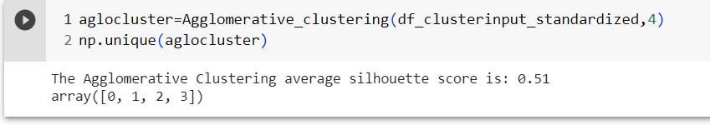
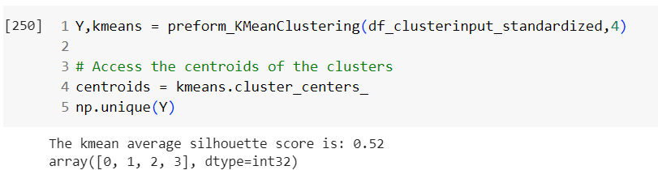
Feature selection
[['GDP','Tourism_Inbound','Energy_Usage',"Tourism_Outbound","Population_Total",'Health_Exp__GDP']] (4 clusters)

Slide 34
Exploring Other Clustering Techniques :
Deep Clustering network: A deep clustering network is a type of neural network architecture that combines deep learning and clustering techniques to learn representations of data in an unsupervised manner. It is commonly used for tasks such as clustering, feature learning, and dimensionality reduction.
BIRCH:BIRCH clustering is a technique that combines the benefits of hierarchical clustering and density-based clustering to provide an efficient and scalable solution for clustering large datasets.
The key idea behind BIRCH is to build a tree-like structure called the CF (Clustering Feature) tree. This tree maintains compact representations of the clusters and allows for fast and scalable clustering. The CF tree has three types of nodes:
Leaf nodes: These represent the actual data points or micro-clusters, which are small clusters formed during the algorithm's execution.
Non-leaf nodes: These represent the intermediate cluster summaries, which contain information about the child nodes' clustering features.
Root node: This represents the overall summary of the entire dataset.

Slide 35
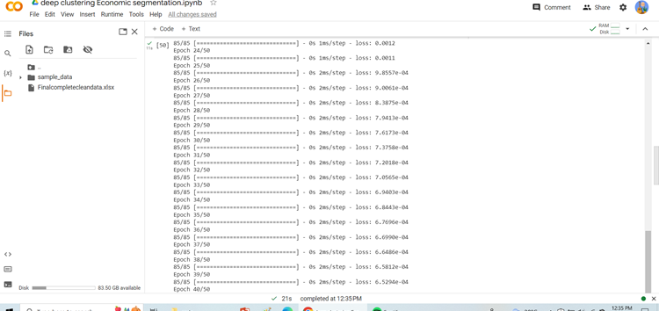
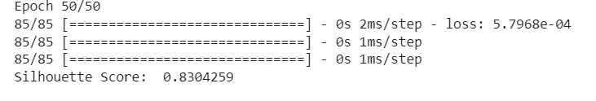
Deep clustering: using tensorflow.keras

Slide 36
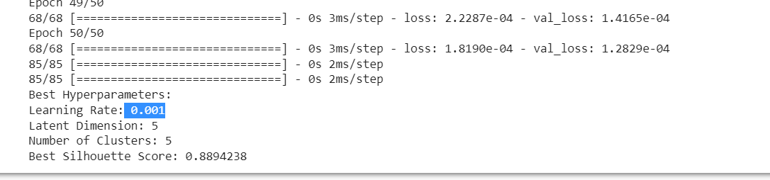
Hyperparameter Tuning:Deep Clustering

Slide 37
CODE Files :
EDA :EDA_P261_Clustering_final
MODEL BUILDING : ALL PARAMETERS
MODEL BUILDING WITH SELECTIVE PARAMETER - Economic Segmentation.ipynb
ADDITIONAL CLUSTERING METHODS: Deep clustering Economic segmentation.ipynb

Slide 38
THANK YOU !

